Slide 1
SAFETY PERFORMANCE MEASUREMENT Unit - III

Slide 2
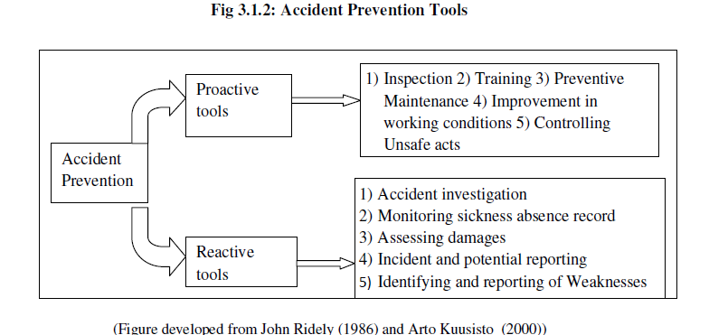

Accident Prevention
A popular assumption holds that increased investment in safety produces improved safety performance
This relationship shows that accident loss will be reduced when investment in safety is increased.
While initial investments have the greatest impact which results in large decrease in accident losses.
For effective accident prevention John R. Ridely suggests amalgamation of three basic arguments: Legal, humanitarian and economic.
The economic argument has great impact on management and also supports legal and humanitarian argument.
John R. Ridely

Slide 3
MEASUREMENT OF SAFETY PERFORMANCE
The logic ‘what that cannot be measured cannot be controlled’ is applicable to injury control also
The historical data would be used as a forecasting tool to predict future incident rates given the level of safety intervention activities
Several qualitative and quantitative approaches have identified for assessment of hazards, the final requirement is an honest efforts to fill the gap between ‘unknown and known’ and then between ‘controlled and uncontrolled’ situations.

Slide 4
Safety performance uses
Safety performance criteria are necessary for carrying out
Comparisons
Estimating Forecasts
Conducting Trend Analysis
Evaluating safety improvement program
Identifying problem areas
Optimal allocation of resources for improving safety
performance
It should posses two characteristics i.e. reliability and validity.
Basically there are two measures of safety performance.
The first is based on ‘outcome indicators’ i.e. Incident Rate, Frequency Rate and Severity Rate which are blamed to be 'negative' or passive measures.
Positive or Service or Active Performance Indicators include number of safety audits conducted, training, corrections and inspections.

Slide 5
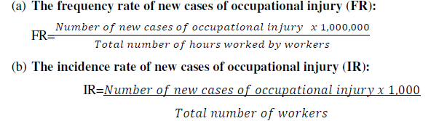
SAFETY OUTCOME INDICATORS
Measures of Safety Outcome
ILO Resolution, 1998 has recommended four measures for comparison and reporting of safety performance:
Frequency Rate (FR)
Incident Rate (IR)
Severity Rate (SR)
Days lost per new case
As per IS 3786 : 1983 and the ILO Code of Practice of Recording and Notification of Occupational Accidents and Diseases the analysis should be done industry group-wise, cause wise, agency wise, nature of injury wise, location of injury wise, sex and age wise.
The following rates are calculated during the reference time.

Slide 6

Incident indicators have been subjected too much criticism mainly because they are a measure of failure, discouraging the safety in-charge, does not allow extrapolation of trends and conclusions. Underreporting of incident may occur if it connected with some kind of reward for staffs
Severity can be measured on the basis of compensation i.e. cost in dollar as well as days lost on account of injury. But cost in dollar changes with space, time and also case to case and thus it cannot be considered as a common base. Hence, common parameter ‘time lost’ is acceptable.

Slide 7
(d) Days lost per new case of occupational injury:
Median or mean number of days lost for each new case of occupational injury during the reference period has its own merits and demerits. In our viewpoint for controlling occupational injury the mean is effective, as it indicates the performance of safety department. Median indicates ‘all is well’ situation.
(e) Frequency Severity Rate:
Frequency severity rate = frequency rate x severity rate
(f) Frequency Severity Incidence (FSI):
While comparing safety performance by FR/SR ratio one difficulty may arise that FR may high and SR may low or vice versa. Therefore FR and SR calculated separately do not reflect true picture of the safety performance. FSI calculated by combining both ratios will serve as better tool.
The FSI of foundry may be higher than that of machine shop. In industry it is accepted that value of FSI shall be up to 1. We have taken into consideration FSI as a measure of accident/injury.

Slide 8

(h) Safe-T-Score
Every factory and shop/block/plant in the same factory has its intrinsic characteristics which exerts different hazardous situation. Hence, its comparison with other plant cannot be justifiable. However, it may be preferred to compare safety performance with its own historical record. Safe-T-Score serves this purpose in order to assess safety performance of middle management.
A positive score indicates inferior whereas negative score is a sign of improved
performance over the past. The score ±2 can be interpreted as variation is insignificant.

Slide 9
Some Sophisticated Measures for calculating Safety Performance Indices
Occupational injury/illness cost index
Westinghouse Hanford Conduct of Operations Event Index
Eastman Kodak safety Performance Index
Average of performance Relatives
Justification formula developed by Dan Petersen

Slide 10
Problem
Using the following data calculate the frequency rate of accident in an industrial plant.
Number of workers=500
Number of disabling injuries per year= 5.
Average number of hours worked by worker per year=2000.

Slide 11
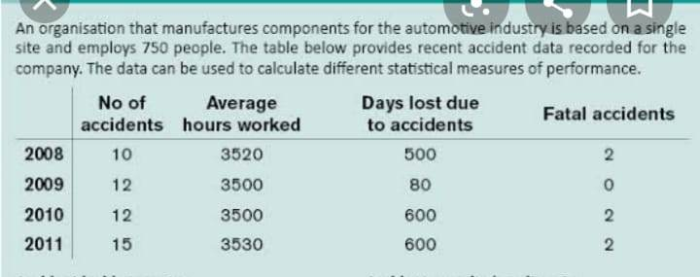
Problem

Slide 12
DISABLING INJURY INDEX (DII)
An index computed by multiplying the disabling injury frequency rate by the disabling injury severity rate and dividing the product by 1,000:
DII = DIFR x DISR / 1000.
This measure reflects both frequency and severity, yielding a combined index of total disabling injury

